Slide 1
HTML5

Slide 2
Version Control and Revision History
 | Name | Date
Prepared By | Manisha Mane | 27-Jul-2018
Reviewed By | Nisha Mendonsa | 27-Jul-2018
Approved By | Gauresh Gaitonde | 27-Jul-2018
Version No. | Date | Section Affected | Highlight of Changes
1.0.0 | 23-Mar-2017 | All | Original Version.
2.0.0 | 27-Jul-2018 | None | Annual Review 2018. No changes made.

Slide 3
Objectives
After completing the session participants will able to
Develop Responsive Web Design (RWD).
Design and enhance using new form elements of HTML5.
Develop and draw on the fly for different types of objects using Canvas API.

Slide 4

What is HTML5?
HTML5 is a markup language for structuring and presenting content for the World Wide Web (WWW).
HTML5 is a W3C specification that defines the fifth major revision of the Hypertext Markup Language (HTML).
Using HTML5 you can build Responsive Web Design (RWD).
HTML 5 is a combination of HTML,CSS and JS

Slide 5

What is HTML5?
HTML5 is a spec in making web pages
Started at WHATWG – Web Hypertext Application Technology Working Group.
HTML5 is a suite of tools for:
Markup (HTML 5)
Presentation (CSS 3)
Interaction (DOM, Ajax, APIs)
HTML5 ≈ HTML5+CSS3 +JavaScript

Slide 6



WHATWG
Web Hypertext Application Technology Working Group
Founded by individuals from Apple, the Mozilla Foundation and Opera Software
Community interested in evolving HTML and related technologies
?

Slide 7
Why HTML5
Search Engine Optimization
Local Storage and cache
Game Development
Cross Browser Support
Improved Semantics and Cleaner Code
Inbuilt Multimedia Support
Interactive
Better data entry and form fields
Simple Doctype
Remote Updates
Hybrid Apps
Accessibility (Semantics and ARIA)
Mobile

Slide 8
HTML5 New Features

Slide 9

HTML5 – New Features
Semantic Elements
Form Elements
Graphic Elements
Audio and Video Support
Web Workers
Web Storage
Geolocation

Slide 10
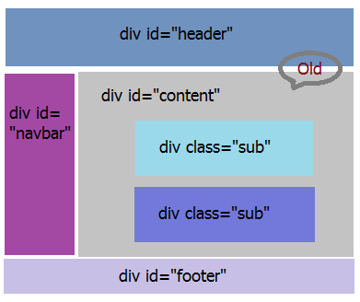
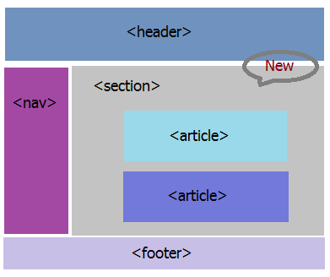
HTML5 – New Features
Semantic Elements
New Elements to define the structure of the web page
HTML4
HTML5

Slide 11
HTML5 – New Features
Semantic Elements
Some of the new elements are:
Header:
Specifies a header for a document or section.
Nav
Represents a major navigation block. It groups links to other pages or to parts of the current page.
Footer
Defines a footer for a document or section
Article
Defines an article
Aside:
The "aside" element is a section that somehow related to main content, but it can be separate from that content
Section
Defines a section in a document

Slide 12
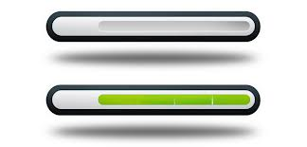

Semantic Elements
Semantic Elements
Some of the new Elements are:
Progress:
Meter:
created to indicate progress of a specific task
To be used when the minimum value and maximum value are clearly defined.

Slide 13
HTML5 New Form Elements

Slide 14


HTML 5 New Form Elements
New Input Types
range
url
email
tel
number
color
date
datalist
Search
New Form Elements
New Form Attributes
New Events
These new features allow better input control and validation.
Not all major browsers support all the new form elements.
If they are not supported, they will behave as regular text fields.

Slide 15

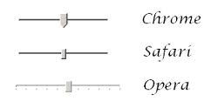

range
The input type=“range” is used for input fields that should contain a value from a range of numbers by declaring the minimum and maximum value. You can also set restrictions on what numbers are accepted.
Choose your Age: <input type="range" name="age" min="18" max="35" />
Choose your Age:
This is intended to be used when the exact value is not important.
Note: All example screen shots are taken by using Chrome browser.

Slide 16
email
The email type is used for input fields that should contain an e-mail address and automatically validated when submitted. <input type="email" name="emailid" />

Slide 17
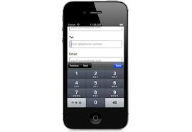

tel
Defines a field for entering a telephone number and automatically validates when the form is submitted. <input type="tel" name="usrtel" />
Note: The tel type is currently supported only in Safari 8.

Slide 18

number
The number type is used for input fields that should contain a numeric value. You can also set restrictions on what numbers are accepted. <input type="number" name="quantity" min="1" max=“2" />

Slide 19
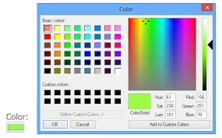
color
The <input type="color"> is used for input fields that should contain a color.
Depending on browser support, a color picker can show up in the input field.

Slide 20
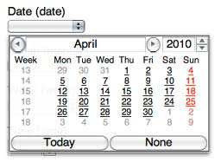
date
The <input type="date"> is used for input fields that should contain a date.
Depending on browser support, a date picker can show up in the input field.

Slide 21

search
The <input type="search"> is used for search fields (a search field behaves like a regular text field).
There is a blue "cross" sign appears in the textbox when you input something in the search box, when you click on the "cross", your input string will be clear and you can start to type a new string.

Slide 22

datalist
Allows to present the user with a range of options to use in a text input box, as well as being able to type in their own.
Simply use the list attribute to connect an ordinary input to a list of options.
<input type="text" name="srch" list="datalist1"/> <datalist id="datalist1"> <option value="India"> <option value="Indonesia"> <option value="Russia"> </datalist>

Slide 23
Audio and Video

Slide 24


Audio
HTML5 provides a standard for playing audio files.
To play an audio file in HTML, use the <audio> element.
The controls attribute adds audio controls, like play, pause, and volume.
Text between the <audio> and </audio> tags will display in browsers that do not support the <audio> element.
<audio controls>
<source src=“im.mp3" type="audio/mpeg">
</audio>

Slide 25


Video
HTML5 provides a standard for playing video files.
To play an video file in HTML, use the <video> element.
The controls attribute adds video controls, like play, pause, and volume.
It is a good idea to always include width and height attributes.
The effect will be that the page will change (or flicker) while the video loads.
<video width="320" height="240" controls>
<source src="movie.mp4" type="video/mp4">
</video>

Slide 26
Canvas and SVG

Slide 27
Canvas
<canvas> tag is used to draw graphics, on the fly, via scripting (usually JavaScript).
<canvas> element has no drawing abilities of its own (it is only a container for graphics) - you must use a script to actually draw the graphics.
getContext() method returns an object that provides methods and properties for drawing on the canvas.
<canvas id="myCanvas" width="100" height="100">
</canvas>

Slide 28

Drawing a Line
To draw a straight line on a canvas, you use these methods:
moveTo(x,y) defines the starting point of the line
lineTo(x,y) defines the ending point of the line
To actually draw the line, you must use one of the "ink" methods, like stroke().
<script type="text/javascript">
var canvas = document.getElementById("myCanvas");
var ctx = canvas.getContext("2d");
ctx.moveTo(0, 0);
ctx.lineTo(200, 100);
ctx.stroke();
</script>

Slide 29
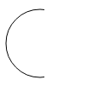
Drawing a Circle
To draw a circle use arc() method.
Arc (x,y,r,start,stop) where x ,y are center of the circle, r is radius and start and stop are start and end points of a circle.
var canvas = docment.getElementById("myCanvas");
var ctx = canvas.getContext("2d");
ctx.beginPath();
ctx.arc(95,50,40,0,2*Math.PI);
ctx.stroke();

Slide 30

Drawing a Text
To draw text on a canvas, the most important property and methods are:
font - defines the font properties for the text.
strokeText(text,x,y) - Draws text on the canvas.
fillText(text,x,y) - Draws "filled" text on the canvas.
var canvas = document.getElementById("myCanvas");
var ctx = canvas.getContext("2d");
ctx.font = "20px Arial";
ctx.strokeText("Hello World",10,50);

Slide 31
SVG
SVG stands for Scalable Vector Graphics which is used to draw graphics on the web.
<svg> element is a container for SVG graphics.
SVG has several methods for drawing boxes, circles, text, and graphic images

Slide 32
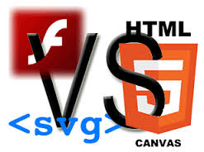
Difference between Canvas and SVG
Canvas | SVG
Resolution dependent | Resolution independent
2D graphics with javascript | 2D graphics in XML
No support for event handlers | Support for event handlers
Poor text rendering capabilities | Best suited for applications with large rendering areas
Well suited for graphic-intensive games | Not suited for game applications
Raster based (composed of pixel) | Vector based (composed of shapes)
Modified through script only | Modified through script and CSS
Single HTML element similar to <img> in behavior | Multiple graphical elements, which become the part of the DOM

Slide 33
Web Storage

Slide 34

Web Storage
Web Storage
Web pages can store data locally within the user's browser.
Is more secure and faster.
The data is not included with every server request, but used ONLY when asked for.
Possible to store large amounts of data, without affecting the website's performance.
Storage items are available on the entire domain.
Two categories of Storage:
Local Storage - stores data with no expiration date
Session Storage - stores data for one session.
Data saved as key/value pairs.

Slide 35
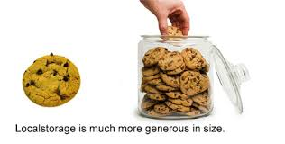
Local Storage
Local Storage provides a persistent data store of up to 5MB.
Each browser will have its own, individual 5MB store.
Secure as data is not shared between browsers.
Is available through the localStorage object

Slide 37

Session Storage
Stores the data for only one session.
The data is deleted when the user closes the browser window.
Session Storage, we have a separate data store for each window or tab that’s open.
Is available through the sessionStorage object
Session Storage solves a problem that’s plagued with cookies:
Assume that you’re shopping for plane tickets online, and you have multiple windows open to try and find the best deal. Even though you have multiple windows open, if the site is using cookies to track your orders, the cookies are all shared across the multiple windows. This could result in accidentally purchasing the same ticket twice.

Slide 38
Test Your Memory
Can localStorage replace Cookies?
No, Cookies and local storage really serve difference purposes. Cookies are primarily for reading server-side, local storage can only be read client-side.
So depending upon the needs:
If it's your client (your JavaScript), then by all means switch. You're wasting bandwidth by sending all the data in each HTTP header.
If it's your server, local storage isn't so useful because you'd have to forward the data along somehow (with Ajax or hidden form fields or something). This might be okay if the server only needs a small subset of the total data for each request.

Slide 39
Web Workers

Slide 40

Web Workers
Defines an API for spawning background scripts
Allows to fire up long-running scripts to handle computationally intensive tasks, but without blocking the UI or other scripts to handle user interactions.
Web Workers run in an isolated thread. As a result, the code that they execute needs to be contained in a separate file
Making JavaScript multi-threaded would require a lot of architectural changes, so Web Workers offers a way around this, enabling the language to be extended so that it can appear to be multi-threaded in certain cases.

Slide 41
Drag and Drop

Slide 42
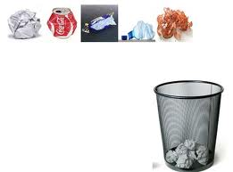
Drag n Drop
Powerful User Interface concept
Provides the ability to natively drag, drop, and transfer data to HTML elements.
Drag and Drop (DnD) API provides the support
<div id="boxA" draggable="true" ondragstart="returnragStart(event)">
dragstart
dragenter
dragover
dragleave
drag
drop
dragend
To drag an element, you need to set the draggable attribute to true for that element.

Slide 43
Geolocation

Slide 44

Geolocation
Geolocation API is used to get the geographical position of a user.
Since this can compromise privacy, the position is not available unless the user approves it
getCurrentPosition() - method is used to return the user's position.
watchPosition() - Returns the current position of the user and continues to return updated position as the user moves (like the GPS in a car).
clearWatch() - Stops the watchPosition() method
Geolocation is most accurate for devices with GPS, like iPhone

